Slide 1
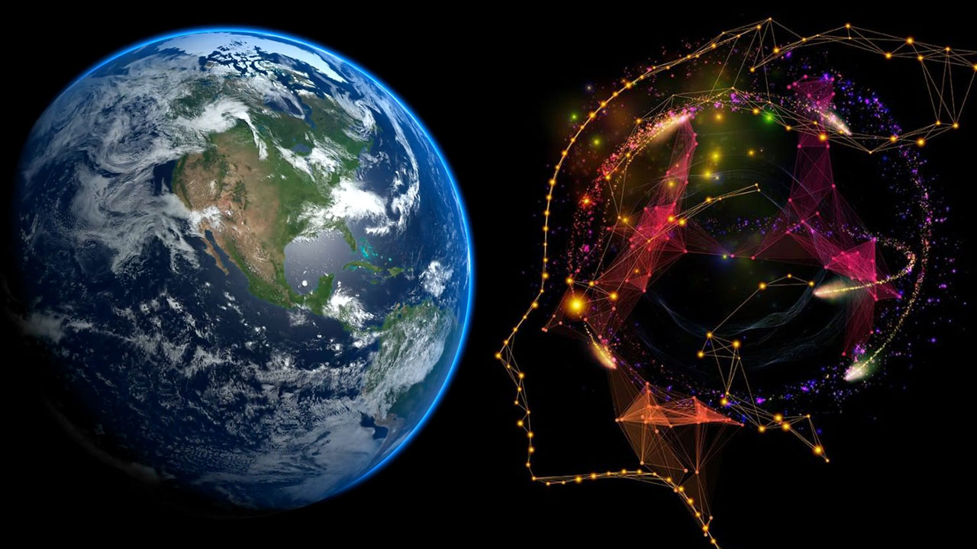
GEO-AI Challenge for Cropland Mapping by ITU.
JULIUS M. MAINA
-Student KCA University (Kenya)

Slide 2
Agenda
Introduction
Proposed solution
Results
Discussion
Conclusion
Presentation Title

Slide 3
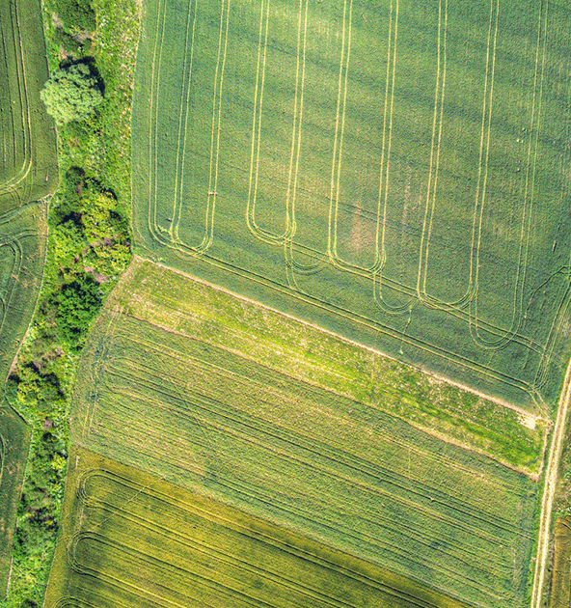
Introduction
Project Objective:
Address the need for accurate global crop maps using advanced machine learning techniques.
Infrequent updates.
Inconsistent definitions of "cropland.“
Project Approach:
Leverage new high-resolution satellite data and machine learning to precise and cost-effective cropland classification models.
Opportunity:
Contribute to global agricultural landscape mapping.
Enhance understanding of crop extents worldwide.

Slide 4

THE APPROACH
-Collect 500 more samples for Afghanistan from GEE within the required timespan by the host.
- Pull bands B1-B12 for the 3 countries from GEE using the latitude and longitudes given
Feature Engineering:
- Location-based information
- Country classification
- Quartile binning band features e.g.
- Soil-related features
- Urban-related features
- Water related features
- Vegetation features
- Geographical clustering to unveil spatial groupings within the data
Preprocessing:
- Cap outliers in the bands
- Label encode the categorical features
Proposed solution

Slide 5
Results
The final dataset comprised of 262 features in total
Accuracy was used to track performance of the models
Initial run with default parameters yielded the following
Model | Accuracy
XGBoost | 0.884
LightGBM | 0.880
HistGradientBoosting | 0.874
Random Forest | 0.866
CatBoost | 0.864
AdaBoost | 0.828
Logistic Regression | 0.682

Slide 6
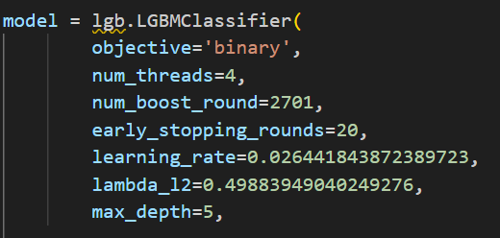
Results
Xgboost and LightGBM seemed to perform well.
LightGBM was selected as the final model for use
A 15 RepeatedKFold yielded the following results
Mean CV Score: 0.870000
Std CV Score: 0.016708
Public Leaderboard: 0.913333333
Private Leaderboard: 0.918095238

Slide 7

Discussion
Expanding the timespan to incorporate longer spans never worked for me, so I stuck with the host’s given timespans (Iran & Sudan-'start': '2019-07-01', 'end': '2020-06-30’ & Afghanistan-'start': '2022-04-01', 'end': '2022-04-30’)
Engineered features improved performance of model. With bands alone Public score was 0.766666666 and private 0.83047619.
Adding more data for Afghanistan only increased performance marginally (from around 0.89 to around 0.9)-1%
Mapping croplands in Afghanistan posed challenges. The average accuracy was approximately 0.8, contrasting with higher averages in Iran (0.95) and Sudan (0.98). Croplands exhibited variability, with some farms being bare and others densely covered with crops.

Slide 8
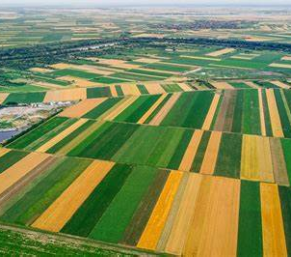
Thank you
Julius Maina
Contact: julmngii@gmail.com

